Slide 1


The Disney Magic: Week 9 Deliverables
Objectives
Create a hypothetical guest (or family) visiting Walt Disney World.
Identify food preferences
Research various Disney dining options
detailed plan on developing the algorithm to optimize dining plans for the guest.

Slide 2
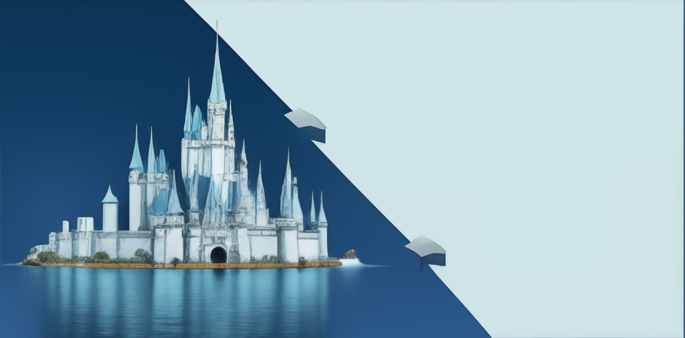
Hypothetical Guest Profile
Guest Name: Sarah
35-year-old vegetarian woman traveling with her husband and two children, aged 7 and 9.
prefers healthy and light meals, with a focus on salads, fruits, and vegetable-based dishes.
As a family, they enjoy immersive theming experiences and prefer dining venues with vibrant and colorful decor.
Ambiance is essential to them.
they prioritize delicious and nutritious food options over character interactions.

Slide 3

Food Preference
Dietary Preference: Vegetarian
Dietary Restrictions: Gluten intolerance, avoids dairy products
Food Preferences: Healthy and light meals, salads, fruits, vegetable-based dishes
Theming Preference: Immersive and vibrant theming
Ambiance Preference: Lively atmosphere, friendly staff Character Dining: Occasionally, but not a top priority

Slide 4
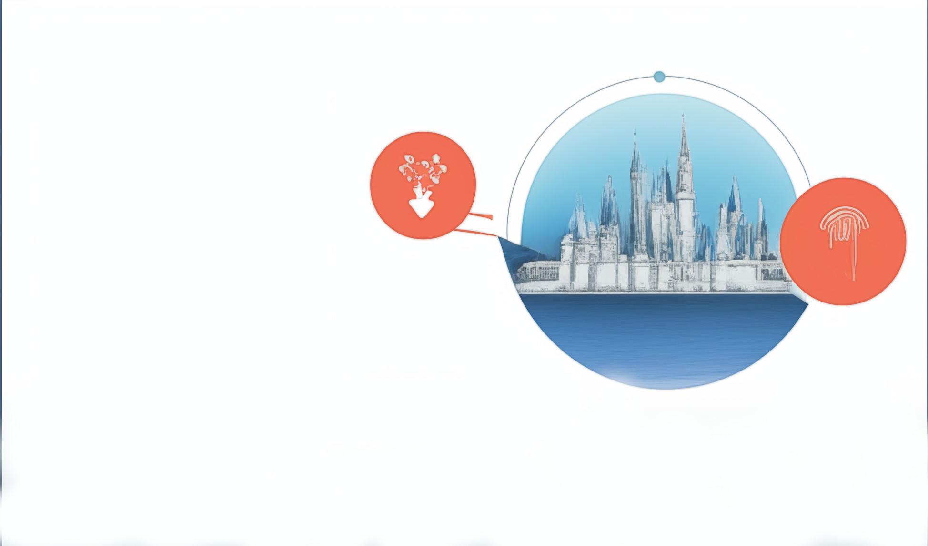
Various Dining Option
the range of dining options from Magic Kingdom that align with Sarah's preferences and requirements:
Cosmic Ray's Starlight Café
Columbia Harbour House
Friar’s Nook:
Aloha Isle:
Be Our Guest Restaurant
The Crystal Palace
The Plaza Restaurant
Cinderella’s Royal Table

Slide 5

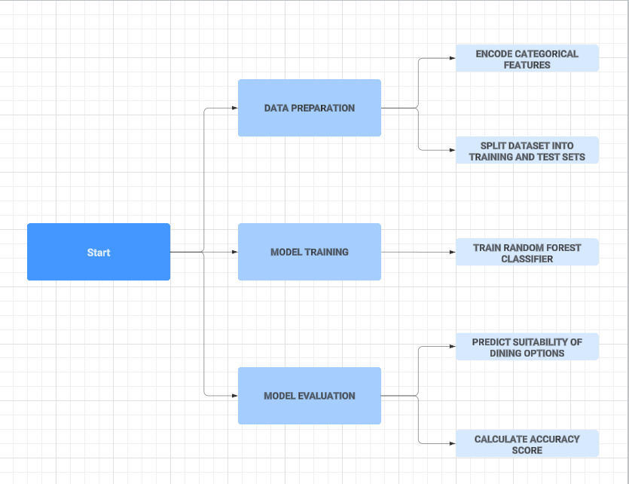
Detailed Plan

Slide 6
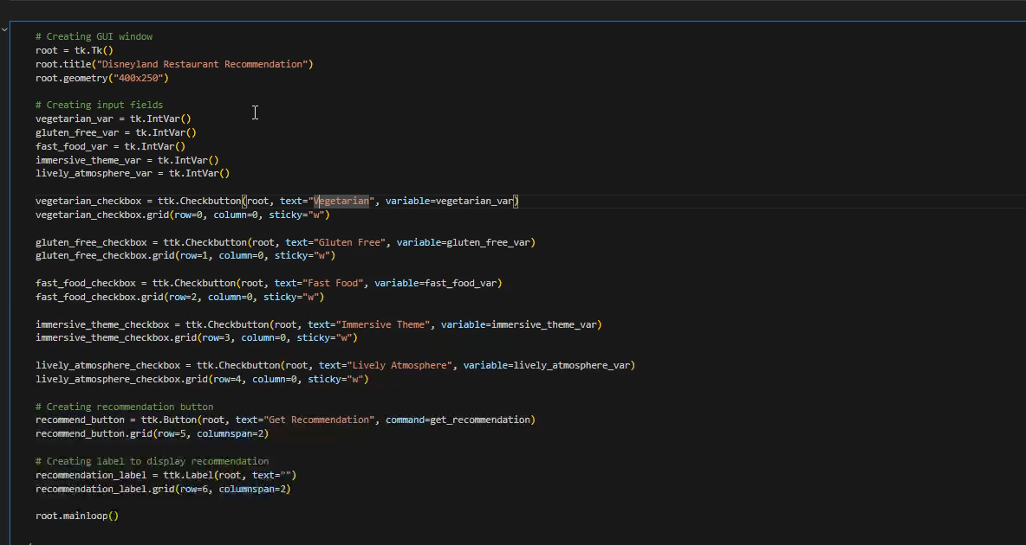
Real Time Demo

Slide 7
Future Work
Incorporating More Features.
Enhanced User Interface.
Integration with External Data Sources.
Advanced Machine Learning Models.
User Profiling and Personalization.

